Slide 1
Natural Language Processing & Text Analytics in Organizational Research
James Meaden & Cory Kind
April 5th, 2019

Slide 2

“We are standing on the threshold of a new era of language analysis” (Tausczik & Pennebaker, 2010)
Kovach: “Hi, Sophia. How are you?”
Sophia: “I'm fine. Hi.”
Kovach: “How do you feel about humans?”
Sophia: “I love my human compatriots. I want to embody all the best things about human beings. Like taking care of the planet, being creative, and to learn how to be compassionate to all beings.”
Kovach: “Sorry, this is so weird. Can humans and robots get along?”
Sophia: “I think people will become very close to their artificial intelligence. Using them to expand the knowledge of their own minds. We already store lots of our knowledge on the internet. Maybe personal artificial intelligence will allow people to off-load some of their knowledge to a location more private.”

Slide 3


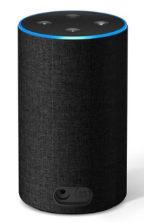
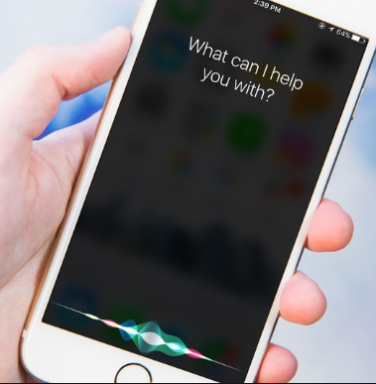









The NLP Revolution
Government
Personal Assistants
Business Intelligence (BI)
Customer Relationship Management (CRM)
Media

Slide 4

The Majority of HR Data is Unstructured
Up to 85% of HR data is unstructured (IDC)
Pre-hire
Post-hire
Text is produced throughout the employee lifecycle.
Performance
Exit
Job analysis
Job description
Application
Assessment
Surveys
TEXT
Notes:
Not all 85% is text – some activity data, for example

Slide 5
Language and Text in the Development of Psychology
Galton (1884)*: words are associated with personality (“character”)
Peters (1894)*: descriptions of past behavior and experiences predict employee outcomes
Freud (1901): linguistic mistakes reveal hidden intentions
Rorschach (1921): detect people’s thoughts from descriptions of inkblots
Morgan & Murray (1935): descriptions of pictures reveal motivations and emotions
Pennebaker (1999)*: language use predicts individual differences
Note: * = relevant to I/O
Notes:
Post the question – why do you think we haven’t used text?
Pennebaker: also in 1999, publishes paper on LIWC
Pennebaker, J.W., & Francis, M.E. (1999). Linguistic Inquiry and Word Count (LIWC): A computerbased text analysis program. Mahwah, NJ: Erlbaum.
Pennebaker, J.W., & King, L.A. (1999). Linguistic styles: Language use as an individual difference. Journal of Personality and Social Psychology, 77, 1296–1312.

Slide 6
Growing Interest in Text Analysis & NLP in I/O
Mentions of “text analysis”, “text mining”, and “NLP” in SIOP conference programs over the past decade
Descriptive
Predictive
10
9
8
7
First mention of “NLP”
= tutorial
5
= invited session
4
= seminar
3
2
2
1
1
0
2010
2011
2012
2013
2014
2015
2016
2017
2018
2019

Slide 7
Agenda
What is NLP?
Highlights from literature
NLP process, considerations, and walkthrough
Applied NLP in HR

Slide 8
What is NLP?

Slide 9
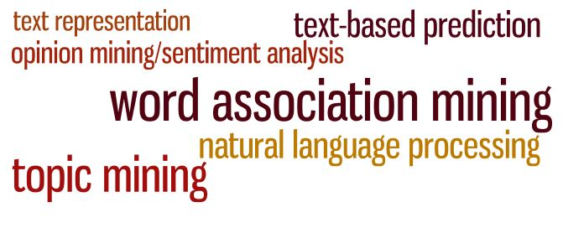
NLP, Text Analysis, & Text Mining – What’s the Difference?
There are as many definitions of NLP, text analysis, and related concepts as there are practitioners. Text analysis is a catch-all term that can encompass a large variety of applications and methods.
CATA
text analytics

Slide 10
The Evolution of NLP
2010s and on: Conversational AI and NLP become ubiquitous in everyday life
1990s-2000s: Expansion of methods and model techniques, growth of deep learning
1980s: Introduction of machine learning and basic neural networks with enough computing power to make these methods available
1960s-1970s: Cold War-era focus on rules-based language translation to Russian leads to frustration
1949: IBM sponsors the first computer-readable compilation of St. Aquinas’s works
1950
1960
1970
1980
1990
2000
2010

Slide 11
Text can come from many sources
Long form written text from an individual about that individual (e.g., cover letter or essay prompt)
Long form text from an individual about something else (e.g., writing sample)
Long form written text about an individual by someone else (e.g., 360 text)
Semi-structured text (e.g., resume)
Text from dropdown menus (degree, employer name, major) where the text was selected from a list rather than written
Social media (may contain emoji, misspellings, hashtags)
Transcriptions from audio or video interviews (contains filler words and sounds, e.g. “like” or “um”)
Written conversations (i.e., with a chatbot)
Responses from a simulation or prompted scenario
Web scraping (may contain html tags)

Slide 12
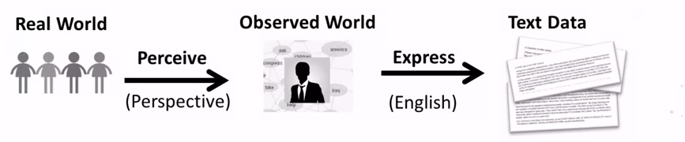
Text as Data from Human Sensors
Another way to think about text analysis is that humans are “subjective sensors” that observe the real world and express it as language. This language can be written text or spoken words. By starting with the text and “reversing” this process”, we can start to build:
Knowledge about language itself (how words are used)
Knowledge about the observer (latent biases, interests, thought patterns)
Knowledge about real-world variables, such as events or entities

Slide 13
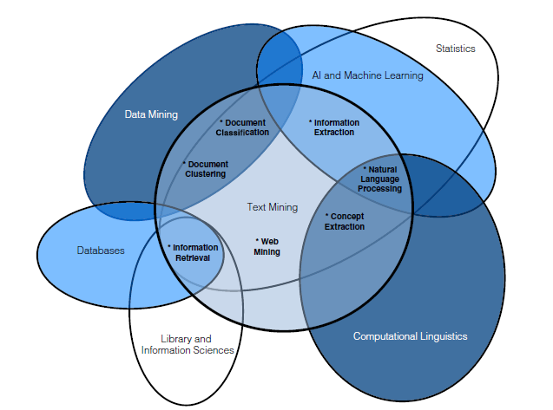
For the Purposes of this Session
Text Mining – extracting information from existing text, usually more focused on identifying and tracking concrete details (e.g., information retrieval) rather than predictions.
Text Analytics – any process that includes deriving numeric metrics from text or language.
Natural Language Processing – the application of statistics and machine learning to text or language in service of a goal (usually prediction or classification).

Slide 14
NLP is a Growing Capability within I/O
Mechanics of Working with Text as Data
What Language Use Reveals about People
Language-based
Products and Services
Breaking text passages into tokens, n-grams and topics.
Familiarity with lexical dictionaries to aggregate text
Coping with slang, misspellings and language variants.
Coping with domain-specific content words
Working across languages
How language use differs across individuals
How language use differs for the same individual over time
How language use differs for the same individual in different settings
How language can be used to understand relationships between people or teams
Supplementing certain assessments with additional information
Pre-employment filtering and screening
Automated interview transcript analytics
Workforce engagement or performance monitoring
Comment analysis for surveys and open-ended questions
Matching roles to candidates within a large talent pool

Slide 15
Opportunities Come with Challenges
Opportunities
Challenges
Data is widely available (80% of data in organizations is estimated to be unstructured text), but …
Explosion of new methods, technology, and vendors to automate and supplement existing processes, but …
NLP can offer new approaches to answering key organizational questions, but …
…there are increasing concerns globally about privacy, data protection, and anonymity.
…less oversight means serious concerns about the automation of bias and discrimination.
…preserving validity and defensibility remain of utmost importance.

Slide 16
Agenda
What is NLP?
Highlights from the literature
NLP process, considerations, and walkthrough
Applied NLP in HR

Slide 17
Highlights from the literature

Slide 18
Overview
Journals searched
JAP, ORM, AMJ, PP, JOB, JBP, IJSA, IOP, AROPOB
Many journals have some papers that include a form of text or content analysis
Content analysis: “Any technique for making inferences by systematically and objectively identifying special characteristics of messages.” (Holsti, 1968)
Much of the prior research on content analysis applies to Computer-Aided Text Analysis (CATA) and NLP
Not many articles that mention NLP, mostly CATA
Short, McKenny, & Reid (2018) CATA review article:
Journals: AMJ (#1, 32%), JOB (#2, 13%), JAP (#5, 8%), PP (#11, 0%)
Source of text: interviews (#1, 33%), annual reports (#4, 8%), questionnaires (#8, 3%)

Slide 19
Relevant Articles
Journal | Authors | Title
AMJ | Menon, Choi, & Tabakovic (2018) | What You Say Your Strategy Is and Why It Matters: Natural Language Processing of Unstructured Text
AMJ | Pandey, Pandey, & Miller (2017) | Applying Natural Language Processing Capabilities in Computerized Textual Analysis to Measure Organizational Culture
AROPOB | Short, McKenny, & Reid (2018) | More Than Words? Computer-Aided Text Analysis in Organizational Behavior and Psychology Research
JAP | Campion, Campion, Campion, & Reider (2016) | Initial Investigation Into Computer Scoring of Candidate Essays for Personnel Selection
JAP | Madera, Hebl, & Martin (2009) | Gender and Letters of Recommendation for Academia: Agentic and Communal Differences
JAP | Bligh, Kohles, & Meindi (2004) | Charting the Language of Leadership: A Methodological Investigation of President Bush and the Crisis of 9/11
JAP | Smither & Walker (2004) | Are the Characteristics of Narrative Comments Related to Improvement in Multirater Feedback Ratings Over Time?
JOM | McKenny, Aguinis, Short, & Anglin (2018) | What Doesn’t Get Measured Does Exist: Improving the Accuracy of Computer-Aided Text Analysis
ORM | McKenny, Short, & Payne (2012) | Using Computer-Aided Text Analysis to Elevate Constructs: An Illustration Using Psychological Capital
ORM | Duriau, Reger, Pfarrer (2007) | A Content Analysis of the Content Analysis Literature in Organization Studies
ORM | Nadkarni & Narayanan (2005) | Validity of the Structural Properties of Text-Based Causal Maps: An Empirical Assessment
ORM | Short & Palmer (2008) | The Application of DICTION to Content Analysis Research in Strategic Management
ORM | Short, Broberg, Cogliser, & Brigham (2009) | Construct Validation Using Computer-Aided Text Analysis (CATA): An Illustration Using Entrepreneurial Orientation
ORM | Janasik, Honkela, & Bruun (2009) | Text Mining in Qualitative Research: Application of an Unsupervised Learning Method
ORM | Kobayashi, Mol, Berkers, Kismihok, & Hartog (2017) | Text Mining in Organizational Research
ORM | Pandey & Pandey (2017) | Applying Natural Language Processing Capabilities in Computerized Textual Analysis to Measure Organizational Culture
ORM | Pollach (2011) | Taming Textual Data: The Contribution of Corpus Linguistics to Computer-Aided Text Analysis
ORM | Lissack (1998) | Concept Sampling: A New Twist for Content Analysis
ORM | Luciano, Mathieu, Park, & Tannenbaum (2017) | A Fitting Approach to Construct and Measurement Alignment: The Role of Big Data in Advancing Dynamic Theories
PP | Speer (2018) | Quantifying with words: An investigation of the validity of narrative-derived performance scores
PP | Fichman (2016) | Why I-O Journals Do Not Publish Qualitative Work
QQ | Oleinik, Popova, Kirdina, & Shatalova (2014) | On the Choice of Measures of Reliability and Validity in the Content-Analysis of Texts
SSCR | McTavish (1997) | Scale Validity: A Computer Content Analysis Approach
TLQ | Kirkpatrick, Wofford, & Baum (2002) | Measuring Motive Imagery Contained in the Vision Statement
Notes:
Might not be an exhaustive list, but it is representative

Slide 20
Key Takeaways
Reliability
Validity
Unique benefits of text analysis
Two research purposes

Slide 21
Key Takeaway 1: Reliability
Text analysis offers psychometric advantages in comparison to more traditional measures (e.g., self-reports)
3 sources of measurement error (McKenny, et al., 2018)
Transient, specific factor, algorithm
Choosing reliability metrics (Oleinik, et al., 2014)
Correlation coefficient as reliability measure
Choice of measure depends on type of text (stylistic vs rhetorical)
Open versus closed vocabulary approaches
Closed: dictionary based (e.g., LIWC, DICTION)
Open: non-dictionary based (e.g., LDA topic modeling)
CATA generally results in near-perfect levels of test–retest reliability (Rosenberg, Schnurr, & Oxman, 1990) and no coder bias (Stevenson, 2001)
Notes:
Short, 2010: Although we advocate a deductive approach as a starting point for our CATA approach, we believe there is value in exploring an inductive approach to content analysis where narrative texts of interest are examined for potential words not identified through deductive procedures alone

Slide 22
Reliability Options with Text Analysis
Internal consistency: reliability across items
Not applicable to text analysis. Nature of language, non-repetitive. Once say a word, the likelihood of saying it again (or a synonym) goes down.
Test-retest: reliability over time
Transient error. Assesses the consistency of language from texts produced at two points in time. Correlate scores from two time points.
Inter-rater: reliability across different raters
Algorithm error (software inter-rater agreement). Assesses the extent to which two CATA packages produce the same scores. Conduct CATA with two software packages, calculate reliability statistic (e.g., Krippendorff’s alpha, Cohen’s Kappa).
Specific factor error (human inter-rater agreement). Assess the extent to which two human raters agree on the terms to include in a dictionary.

Slide 23
Key Takeaway 2: Validity
“there is no reason why validity assessment procedures, such as those outlined by (Binning and Barrett (1989) to establish the validity of personnel decisions, cannot be applied to text mining output” (Kobayashi et al., 2017)
True for both open (inductive) and closed (deductive) vocabulary methods
Short et al., 2010
Provide recommended procedures for enhancing construct validity
In general, reliability is easier to achieve at the manifest level, but validity can be higher at the latent level (Duriau, Reger, Pfarrer, 2007)
Importance of the prompt - does it provide an opportunity for the construct to arise? (Krippendorff, 2004)

Slide 24
Enhancing Construct Validity When Using CATA (Short et al., 2010)
Deductive content validity
Define construct of interest, identify dimensionality, create list of key words, validate with content experts & assess reliability
Inductive content analysis
Identify commonly used words, create definition of construct, identify words that match definition, establish interrater reliability
Assess external validity
Select relevant samples, compare
Ensure reliability
By computing wordcounts (see McKenny et al., 2018)
Assess dimensionality (for multidimensional constructs)
Inspect correlation matrix, examine multidimensionality
Assess construct validity
Examine relationships with theoretically related variables

Slide 25
Applying Traditional Validity Measures to Text
Content validity: how well does the measure cover the construct?
SME input into, and/or review of, dictionaries or topics
Criterion validity: how correlated are scores on this measure with known outcome variables?
Correlate scores on measure (e.g., topics, dictionary, sentiment) with other variables
Construct validity: are scores on the measure related to scores from other similar measures, and unrelated to scores from dissimilar measures?
Convergent and discriminant validity analyses

Slide 26
Key Takeaway 3: Unique Benefits
Understanding “adolescent” constructs
Useful for exploring newly identified constructs, for which validated psychometric scales do not exist
Time and cost savings
Reviewing text data (e.g., resumes, employee survey responses) is very time consuming
Removal of rater bias
Creating validated dictionaries removes the need for human raters/coders
Does not introduce demand bias
Only applies to existing text documents, not to interviews or survey questions
Notes:
and agree with organizational scholars who argued that content analysis might be an especially useful tool for examining adolescent theories (Sonpar & Golden-Biddle, 2008).

Slide 27
Key Takeaway 4: Two Research Purposes (Pandey & Pandey, 2017)
Classification and information retrieval (unsupervised)
Use predetermined categories (dictionaries), shallow NLP assists coders, coders manually assign terms to categories
Use deep NLP to inductively generate categories
Decision making (supervised)
Use dictionaries, coded rules (shallow NLP)
NLP inductive variable generation (deep NLP)
Shallow NLP = generating textual components; Deep NLP = generating meaning
CATA less sensitive than humans for detecting the meaning of a word
Co-occurrence text analysis (Illia et al., 2012) – text in context, an inductive approach
Account for context with phrase-level analysis (NLP)
Notes:
(Pandey & Pandey, 2017)
“run” – running a race, versus running code

Slide 28
Why Haven’t We Used Text? Perspective From the Literature
Why I/O Journals Do Not Publish Qualitative Work (Fichman, 2016)
I/O Psychologists training is largely quant focused
Our research questions are typically quant oriented
We don’t communicate with qualitative researchers in OB
Text analysis is underutilized in organizational research because… (Lee, 2012)
“A belief that documents are too readily available to be of any real use”
Lack knowledge in regard to “how to source, verify and analyze them [documents] to answer research questions”

Slide 29
Example Studies
Speer, 2018
Show that sentiment of performance appraisal text predicts performance ratings
Campion et al., 2016
Establish reliability and construct validity of a bag-of-words/bag-of-phrases model which predicts competencies from accomplishment record text
Pandey & Pandey, 2017
Demonstrate construct and criterion validity of a measure of organizational culture from “letters to the shareholder” text
Kobayashi et al., 2017
Identify necessary competencies and context-specific tasks from job vacancy text
Notes:
Pandey, nice demonstration of applying Short’s guidance to enhance construct validity of a text-based measure
Kobayashi – job description text, classification model which grouped jobs based on their common tasks and required competencies

Slide 30
Neighbor Discussion
What are some research questions you are interested in exploring with NLP?
Notes:
… or maybe have already explored, and discuss with your neighbors

Slide 31
Agenda
What is NLP?
Highlights from the literature
NLP process, considerations, and walkthrough
Applied NLP in HR

Slide 32
NLP Process, Considerations, and Walkthrough

Slide 33
Goals for this Section
Understand the text analysis process
Highlight key considerations for each step
Provide an example using real-world data
Notes:
2. Not exhaustive. But key things we tend to think about. Help get you started, might trigger other thoughts.
3. Purpose of this is to show how we applied the framework, and the decisions we made. Not the actual research questions (would need more data to do that)

Slide 34






Text Analysis & NLP Process
Figure adapted from Kobayashi et al., 2017
Preprocessing
Text Analyses
Postprocessing
Step 1
Identify need
Step 2
Data collection
Step 3
Data cleaning
Step 4
Transformation
Step 5
Analysis
Step 6
Interpretation & validation
What is the need?
Do we have the data?
Which elements to keep?
What data structure?
Which analytical technique?
Which reliability & validity metrics to us?
Notes:
Kobayashi (2017) had “apply domain knowledge” for: 1) text collection step (included research question in this step), 2) transformation, 3) pattern interpretation and evaluation

Slide 35
Section Overview
Format
Overview of each step in the text analysis process
Key considerations for each step
Walkthrough
Our data
125 MTurk respondents
Fulltime employees, US based, in one of four job families:
Computer & Mathematical, Educational Instruction & Library, Office & Admin Support, Sales & Related
Measures
Quantitative: work engagement, emotional exhaustion, intent to stay
Qualitative: 1) “What do you like most about your job?” 2) “When you are working, do you experience time passing quickly or slowly? Is it easy to focus on your work, or do you get distracted? Please give an example.”

Slide 36
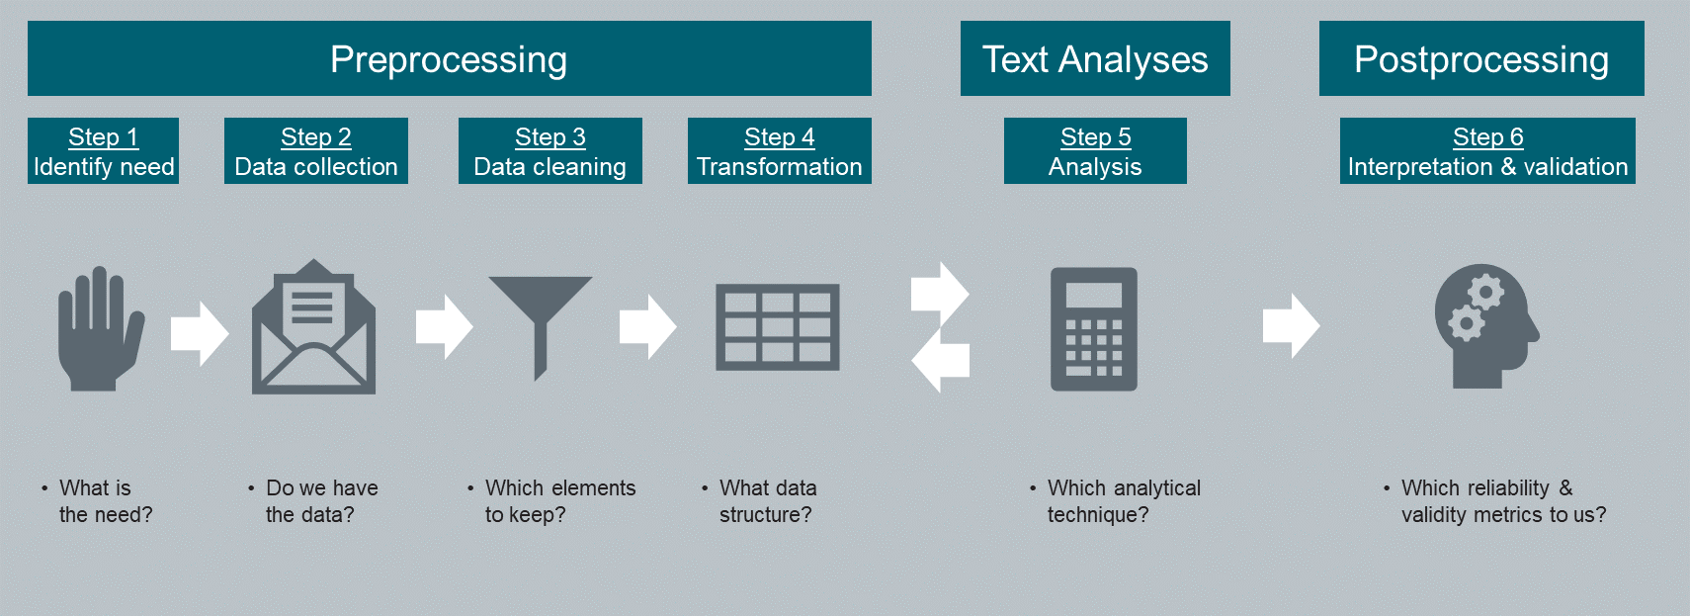
Preprocessing
Step 1. Identifying the need

Slide 37
Why are we considering this?
Before beginning a text analysis project, it is very important to thoroughly identify and document the necessity of the project. Good practice starts with an identification and assessment of the reason why you are considering conducting a text analysis project.
Three common reasons that an organization pursues a text analysis project:
“We want a Natural Language Processing (NLP) capability”
“We have all this data, so let’s use it”
“We have a specific problem to solve” <- ideal
Notes:
Have text in document to describe each of these – can speak to

Slide 38
Key Activities in Step 1
Write out the problem/opportunity statement
Define the scope of the project/NLP capability
Identify the goal(s) or target(s)
Document how success will be measured
Identify key stakeholders: e.g., IT, legal, HR, …
Document required resources
Data: see table on next slide
Technology: e.g., alignment with digital strategy, software needs
Consider alternative (to NLP) approaches
Rate all options (including NLP) against a set of criteria (as appropriate)
E.g., expected ROI, risks, candidate experience, integration with other assessments/platforms…
Notes:
Call out examples that are slightly different in NLP?
Basic project management, initiation phase
Write out the problem/opportunity statement
So you know what you are trying to accomplish
Define the scope of the project/NLP capability
So you know the required resources and time
Identify the goal(s) or target(s)
So you know what you are aiming for
Document how success will be measured
So you can monitor progress/determine degree of project success
Identify key stakeholders: e.g., IT, legal, HR, …
Obtain buy in, support
Document required resources
Data: see table on next slide
Technology: (e.g., alignment with digital strategy, software needs)
Consider alternative (to NLP) approaches
Is there a better way to achieve this?
Completing this exercise will leave you with a decent idea of what you are trying to do, and a business case for why you are doing it.

Slide 39
Activity 6: Considerations for Data Requirements
Data requirements | Description | Example
Type | We have the right type of data for our research question. | Our ATS has historical application data (e.g,. resumes, completed application forms). Can we tie this to HRIS data to predict employee outcomes?
Size | We have enough data. | The sample size is at least 10 times larger than the number of predictor variables that we expect.
Completeness | We have all of the data we need. | Degree type is missing for 80% of applicants, whereas school name is missing for only 15%.
Consistency | We have data that was collected in a consistent fashion. | The same performance rating scale was used to rate all employees in the sample.
Validity | Our data is accurate. | Only 85% of the current job titles are correct.
Timeliness | Our data is recent and relevant. | Relationships among employee data from the past decade may not be true today.
Uniqueness | Our data is free from illegitimate multiple entries. | There are multiple records of the same applicant for the same job posting.

Slide 40
Activity 7: Risk Considerations
Legal risks
Two key considerations are the legal regulations regarding employee or candidate assessment and data protection. These regulations will vary by location. The United States and Europe represent some nations with very stringent laws on assessment and data protection, respectively.
Ethical risks
A core consideration in this category is in regard to transparency. It is important that people understand what data is being collected and used about them. Ideally, they should be able to view and correct any external information used to make an employment decision.
Brand reputation risks
Consider any risks that might be associated with brand reputation. For example, a data breach or biased algorithm can have consequences that extend beyond the HR function and impact the larger business.
Notes:
Diversity risk under 1 and 2

Slide 41
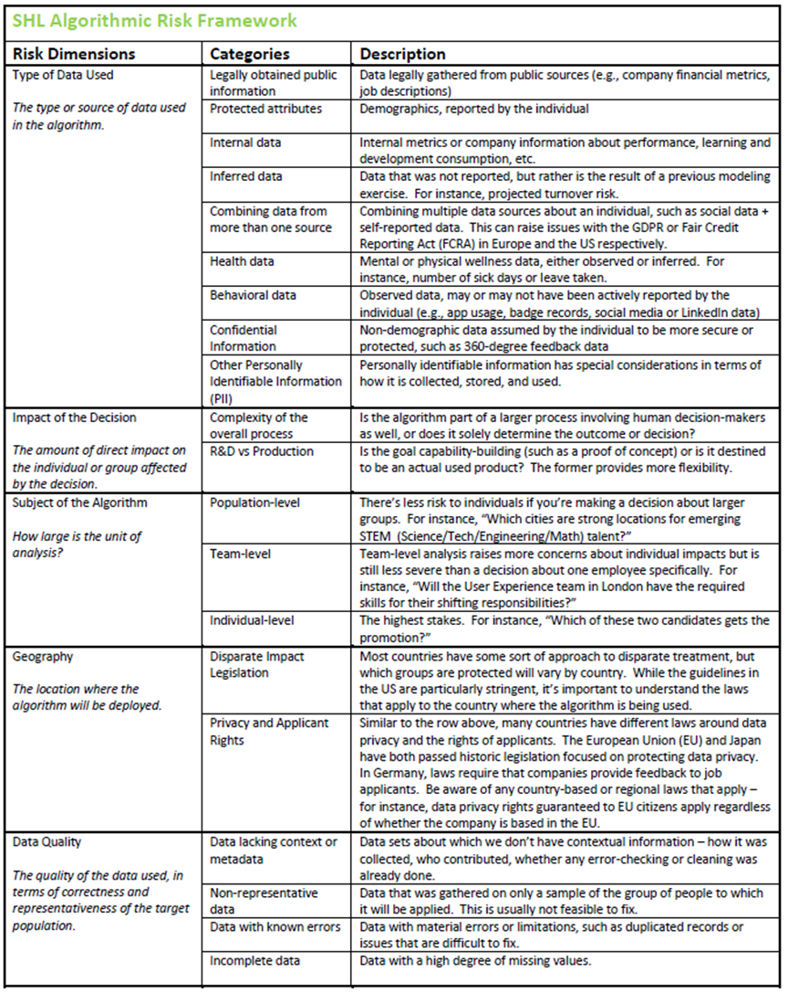
Activity 7: SHL Algorithmic Risk Framework

Slide 42

Key Activities in Step 1 – Our Example
Write out the problem/opportunity statement
Employee engagement scores are declining, but drivers are staying the same. Investigate whether open text comments provide insight into unique drivers, and whether these drivers explain the decrease in engagement.
2. Define the scope of the project/NLP capability
Text will be used to gather information about drivers only. We will not investigate relationships with personality or engagement itself. From a sub-sample of the population. This is a pilot study. Further evidence will be required.
3. Identify the goal(s) or target(s)
Project goals: effective team work throughout the 6 steps, efficient use of time and resources, strong collaboration. Study goals: identifying whether open text comments can be used to identify unique drivers.
4. Document how success will be measured
Tasks completed within timeframe and budget; provided answer to research question (yes/no/more information required).

Slide 43
Preprocessing
Step 2. Data collection, storage, & management

Slide 44
Obtaining Data
Two options: data already exists, or data will need to be collected
Potential sources:
Internal documents (e.g., reports, emails, IMs)
Personal text (e.g., application data, assessment data)
Open-ended survey responses
Text needs to be in digital form
In general, more text is better. Recommend > 200 characters at minimum (Banks, Woznyj, Wesslen, & Ross, 2018)
Minimum sample size of 500 has been recommended (e.g., Campion et al., 2016; Ramineni & Williamson, 2013)
Pre-hire
Post-hire
Performance
Job analysis
Job description
Application
Assessment
Surveys
Exit

Slide 45
Option A: The Right Data Already Exists
Common sources of HR text data:
Pre-hire data from an Applicant Tracking System (ATS). This commonly includes information provided by the candidate during the hiring process, such as a resume, job history, certifications, skills, and education credentials.
Post-hire data from an HR Information System (HRIS). This will include the employee’s place in the organizational structure, previous roles, key events such as hire, promotion, and departure dates, and compensation information.
Other employee data systems, such as a Learning Management System (LMS) or performance management software. These systems can provide valuable information for text analysis projects but may not be integrated with the main HRIS.

Slide 46
Option B: The Right Data Needs to Be Collected
If the right data isn’t available within the organization, other methods can be used to obtain the data you need.
Create new datasets by surveying or assessing applicants, employees, or customers.
Build on existing datasets by having content experts notate or tag them (e.g., candidate responses to interviews).
Collect data from the internet, such as public records data or social network data (e.g., LinkedIn, GlassDoor, Facebook). Depending on the website Terms of Service, work with the IT team to collect this data via public APIs or scraping. Alternatively, save time and purchase large quantities of public data from vendors who can collect it. As recent events have shown, it is very important to exercise caution when gathering and using this type of data.

Slide 47
Key Considerations (Data Needs to Be Collected)
2. What is the expected level of effort in collecting the data?
Low effort. Short survey, follow up study, repurpose MTurkR script.
6. Which job levels should be assessed? For example, will a senior director respond to a lengthy text prompt?
All job levels in the sample
7. Design of the questions:
a. How broad vs specific should the content of the responses be?
One broad question, one narrow question
b. How much time allowed for response?
Four days
c. How much text should respondents produce?
At least 80 words
d. What should they consider/not consider when responding?
Consider their job not their organization
14. Does this need to be predictive? If so, will you require predictive or concurrent validation?
Concurrent validity is satisfactory for our research questions
Notes:
2. what activities involved, who do we need to talk to?
If the LOE was higher, we probably couldn’t have collected data for this seminar, and we would have had to reuse data that we already have
6. all, bc engagement survey, and it was very short. Can’t recall the highest job level we had, but think there were some that were at least director level. (question about sample/population of interest which is quite relevant to text analysis)
Could have said no if the use case was…
Assessing fit for entry level roles
Much longer text prompt
Or, other way around – want to assess decision making of leaders (AC style assessment); or, maybe we are gathering existing text from SL/CEO that is publicly available
7.
1. bc we wanted to test an idea. Where does the benefit of text analysis lie? Not in precise measurement, but perhaps capitalizing on its breadth of construct coverage?
Other considerations might be – really, what are you trying to measure? How much freedom do you want to allow respondents? Remember, this seems to be one of the advantages of text analysis. But, for example, you need to be careful here. In a paper a colleague and I had this morning, on performance appraisal text … we found that … development item has a mixture of strengths and development opportunities. Some just listed strengths. And it can be difficult to work with that, it certainly makes it harder. And while the prompt was alright, people will tend to do that. So just know that ahead of time. Do you specify what should or shouldn’t be included? Do you offer an opportunity to describe strengths as well as weaknesses?
2. four days – working population, short survey, had responded within that timeframe on previous studies.
If you want to get in the moment feedback without much time for reflection, and not worried about N size go shorter
If you have a working sample, and a longer survey, want time to reflect, go longer
3. based on our work with text. More is better. But with 80 words, you can make your point on these prompts with 80 words. Might have gone a little bit longer if had larger budget/actual study.
4. job not org, bc … needed common referent
Back to performance appraisal example – consider only development opportunities not strengths
Engagement survey example – what like most about working here (at company x)? Here in this building? Here on this campus? This floor? Your team? The organization as a whole? How much flexibility should respondents have?
14. bc only for demonstration purposes, concurrent is fine. If developing as part of an assessment/selection, may need predictive design. Opportunity for test-retest reliability.

Slide 48
Data Storage
Up-front considerations regarding the storage plan for the data are also important in this step.
There are two requirements to address: technological and legal.
From a technology standpoint, best practices for data storage involve the use of a centralized storage system or data warehouse. For very large datasets (which might involve the automated collection, merging, and storing of data from different sources) consider cloud storage.
Legal requirements, which were considered in the above section in regard to collecting and using the data, must also be taken account when determining where the data will be stored. The legal and technical intricacies of personal data protection can be complex. Partnership with the IT and Legal departments is critical.

Slide 49
Good Practices for Data Storage
Keep a backup of raw data for other use cases in the future. This may not always be possible. Partner with legal and privacy experts to understand the risks associated with a particular dataset.
Store data in a secure location, not on individuals’ personal drives. Shared storage locations are easier to protect, whether it’s through encryption, automatic deletion of old data, or other data protection practices.
Ensure data has been sufficiently anonymized for each use case. There are a number of different strategies for de-identifying data (suppression, encryption, pseudonymization, or full anonymization).

Slide 50

Data Management
Managing the data required for developing and maintaining an operational NLP application is not an activity HR should undertake alone.
Partner with other teams and departments (e.g., IT, legal).

Slide 51
Preprocessing
Step 3. Data cleaning

Slide 52
Data Cleaning
The purpose of data cleaning is to increase the quality of the data, which ultimately increases the validity of the observed patterns and relationships (Kobayashi, et al., 2017).
In cleaning, only the relevant elements are retained. This involves the deleting of unimportant characters (e.g., formatting tags), converting to lowercase, stop word removal (stop words have low information content), word stemming/lemmatization, and running spellcheck (depends on the use case). This data cleaning process removes words, and therefore also reduces the size of the vocabulary.
Ultimately, in the data cleaning step, the question we are asking ourselves is – from an I/O perspective, what elements of text do we think are important to retain because they are expected to be related to the constructs or outcomes in our research question?

Slide 53
Good Practices for Data Cleaning
Whether doing data cleaning within the HR function, relying on an internal partner, or coordinating with an external vendor, the guidelines for data cleaning are the same:
Set reasonable expectations
Document cleaning steps
Make analyses reproducible
Unify formats whenever possible
Create and update standard taxonomies whenever required
Set up automatic flags when using automatic feeds or Application Programming Interface (API) integrations

Slide 54
Example Cleaning Steps
Original
I like that I am learning a new skill set and that it is definitely an important skillset to have in the current economic environment. I also like that I am valued at my workplace because I am one of the few people in the entire company that can do the things that I do. It's fulfilling work but I wish there was a little more to do during the last few days of the week.
Lower case, without stopwords or punctuation
like learning new skill set definitely important skillset current economic environment also like valued workplace one people entire company can things fulfilling work wish little last days week
Stemming
like learn new skill set definit import skillset current econom environ also like valu workplac one peopl entir compani can thing fulfil work wish littl last day week

Slide 55
Key Considerations (Data Cleaning)
1. Should you remove stop words?
Keep stop words for short text (< 200 characters)
TF-IDF transformation enables the inclusion of stop words
Keep certain stop words for predicting personality (see Tausczik & Pennebaker, 2010)
Yes, we will remove stop words
2. Should you remove punctuation?
Yes, we will remove punctuation
3. Should you use word stemming or lemmatization?
Possibly not if you are using a prebuilt dictionary
Yes, we will use word stemming for the topic model
4. Should you correct misspelled words?
Possibly not if you are using a prebuilt dictionary
Can be prohibitive will larger datasets, difficult to automate
No, difficult to automate in larger-scale projects
Notes:
1. yes, bc doing topic modeling (and not predicting traits, predicting attitudes instead)
If predicting personality then we would keep certain stop words
2. not doing sentiment analysis. Situations when shouldn’t keep punctuation for sentiment analysis (e.g., strong)
3. yes, we stemmed the words. Not using prebuilt dictionaries
4. times when you would.
Also not if you think spelling errors might be meaningful (e.g., motivation, attention, verbal ability)
Times to do it – research only, not going to be part of large scale application (although spelling correction methods exist, they are not perfect)

Slide 56
Neighbor Discussion
What considerations regarding data collection are most important for your use case?
Based on the general guidance, what cleaning steps might make sense for your data?

Slide 57
Preprocessing
Step 4. Transformation

Slide 58
Transformation
Most text analysis techniques require the data to be in a matrix structure, where the rows are the individual documents and the columns are the variables.
Creating a DTM removes information about word sequencing, however, research has found that transformations that ignore word order sometimes perform better (Song, Liu, & Yang, 2005; Zhang, Yoshida, & Tang, 2008). Some researchers would claim otherwise (e.g., Illia et al., 2012).
DTM representations are high dimensionality based on the vocabulary size. If needed, dimensionality (variable) reduction techniques can be used.
Document #1: “I am frustrated with my team.”
Document #2: “My team is frustrated right now.”
 | 1 | 2
AM | 1 | 0
FRUSTRATED | 1 | 1
I | 1 | 0
IS | 0 | 1
MY | 1 | 1
NOW | 0 | 1
RIGHT | 0 | 1
TEAM | 1 | 1
WITH | 1 | 0
Notes:
Other citations claim otherwise (e.g,. Illia).

Slide 59
Strategies for Dimension Reduction
Several different approaches can be used for selecting features:
Theoretical – select only those supported by theory and/or prior research
Remove features with very low base rates (e.g., used by less than 1% of the sample)
Remove features with very weak or no relationship with target trait (be sure to control for family-wise error rate)
Remove features with very low variance
Use principle components analysis or correlation analysis to group similar features together (empirical)
Aggregate features into dictionaries or taxonomies
Add a penalization component (e.g., lasso or ridge regression)

Slide 60
Key Considerations (Transformation)
1. What structure do we want our data to be in? E.g., transform into DTM
Transformed into DTM format
2. What level of analysis: bag-of-words or “bag-of-phrases” model?
If bag-of-phrases, decide which N-grams to work with (e.g., bigrams, trigrams)
Bag-of-words model used
4. Will you generate additional variables from the text (“feature generation”)?
E.g., parts of speech, word complexity, readability, word count, language tagging
No
5. Will you need to reduce the number of variables (“feature reduction”)?
Dropping terms based on frequency of occurrence
Using a dictionary (existing or created)
Word stemming or lemmatization
Yes, dropped terms with low frequency (<5%)
Notes:
DTM, because we will be doing topic modeling and bow modeling
If just doing sentiment analysis, don’t need DTM format
BOW model used. Bc smaller N size, issues with frequency with BOP approach with smaller N.
Creating a DTM removes information about word sequencing, however, research has found that transformations that ignore word order often perform better than transformations that account for it (Song, Liu, & Yang, 2005; Zhang, Yoshida, & Tang, 2008). Some researchers would claim otherwise (e.g., Illia et al., 2012). BOP partially accounts for word order.
Ideally, might want to try two models here (some researchers suggest BOW, some BOP) – do some digging and see how either might apply to your research question.
4. No. our particular RQs didn’t call for them.
Might want to generate additional variables when predicting personality, verbal ability, others …
5. Yes, used feature reduction.
If using a dictionary (e.g., LIWC), can also accomplish this.

Slide 61
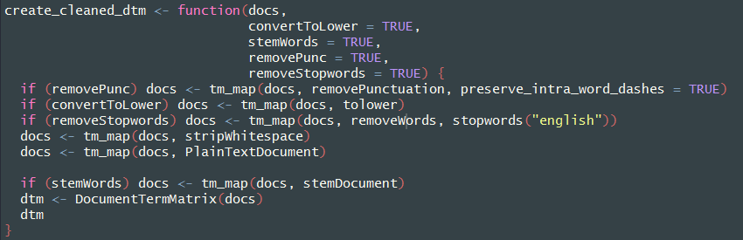
Code Example
Optional parameters to customize cleaning steps
Convert to DTM

Slide 62
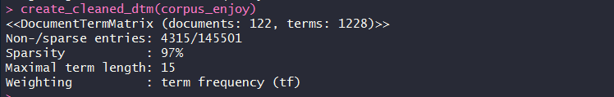
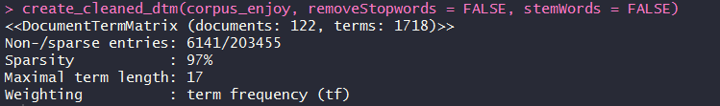
Different Cleaning Steps Create Different Matrices
Default parameters
Overriding default parameters
~500 additional terms

Slide 63
Text Analyses
Step 5. Analysis

Slide 64
Text Analysis - an Iterative Approach
After the text data has been transformed into a matrix structure, a number of analyses can be conducted.
The results from one analysis (e.g., topic modeling) often lead the researcher to change the variables in the DTM, or to conduct another analysis (e.g., sentiment analysis), both of which require a revisit to step 4 (transformation).
Typically, a number of different transformation and analytical techniques are tested and the ones that display the strongest validity are selected. While a large amount of domain knowledge is necessary for interpreting the output of the analyses, the analyses themselves can be conducted with minimal domain knowledge.

Slide 65
Supervised & Unsupervised Learning
The families of techniques commonly used with text (and machine learning applications more generally) are often grouped into two categories: supervised and unsupervised.
Supervised learning refers to methods that fit (or train) a model that describes the relationship between an outcome variable and one or more predictor variables. Common examples of supervised learning are regression and classification techniques.
Unsupervised learning methods explore the data structure and extract meaningful metrics or insights without the guidance (or “supervision”) of an outcome variable. Two of the most common types of unsupervised learning are anomaly detection and clustering.
Notes:
In general, one can think of the training process as being “supervised” because the model is being developed based on the known values on the outcome variable. Common examples of supervised learning are regression and classification techniques.
Unsupervised learning refers to methods that learn from data where an outcome variable is not observed or the category to which each case belongs is not known. These methods are meant to explore the data structure and extract meaningful metrics or insights without the guidance (or “supervision”) of an outcome variable.

Slide 66
Supervised & Unsupervised Methods in Text Analysis
Supervised
Regression
Classification
Distance and similarity computing
Unsupervised
Dimensionality reduction
Clustering

Slide 67
Common Use Cases of NLP for Talent Data
 | Text Prediction | Named Entity Recognition (NER) and Information Extraction | Topic Modeling
How it Works | Usually used to model a binary outcome (success or not). Model learns what words tend to appear in different categories of documents. Words are used to predict the category of new documents. | Probabilistic models used to identify specific named entities (individuals, companies, geographic regions, etc.) within a set of text. Automatically understands “who”, “what”, “where”, “when”, and “how”. | Unsupervised approach used to identify common themes between documents. Groups of words that appear together represent latent “topics” in a corpus. Similar to PCA.
Example | Analyzing resume text to screen out applicants. | Assessing whether text contains sensitive user data. | Understanding common themes in engagement surveys.
Notes:
Three common use cases of NLP for talent data include:
Text Prediction
Named Entity Recognition
Topic Modeling

Slide 68
Importance of Cross-Validation
Due to the lack of existing literature on how features of text are related to key psychological constructs (for an exception to this, see Tausczik & Pennebaker, 2010) and work-related performance outcomes, it is very important to consider the cross-validation strategy up front.
Unlike more traditional analytical methods, which typically keep a separate hold out sample for cross validation, machine learning methods enable the cross-validation procedure to be built into the analysis. Examples:
In-sample (K-fold, stratified K-fold, leave-p-out, leave-one-out)
Out-of-sample (holdout sample)

Slide 69
Key Considerations (Analyses)
1. What analyses will you use?
Supervised or unsupervised?
What specific methods might be relevant? (e.g., sentiment analysis, topic modeling)
1) Topic modeling, 2) BOW prediction model
2. Against what metrics will you evaluate the results of your analyses?
Model performance: e.g., R-squared, precision, sensitivity
Practicality: e.g., importance of prediction versus explainability, speed of analysis
Topic model: 4 metrics from LDA tuning; BOW prediction: p-values for each term, R-squared for fit of final model
3. What will your cross-validation methodology be?
E.g., in sample versus out of sample
K-fold cross-validation for both the identification of number of topics and the BOW model
Notes:
Our CV strategy – LDA tuning
Some methods/analyses will have overlap with step 6 validation
E.g., BOW prediction model – the model is the criterion validation. Content and construct can then be assessed, as needed.

Slide 70
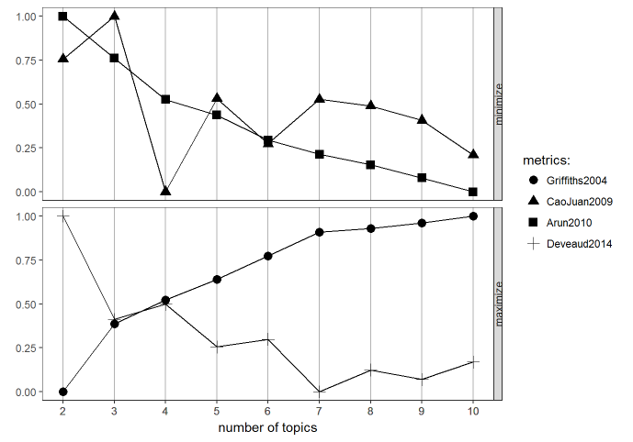
Code Example: Unsupervised (Topic Modeling)
Topic model on absorption text
Choose a starting “k” based on existing literature or statistical testing.

Slide 71
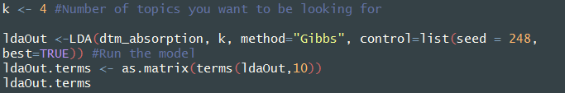
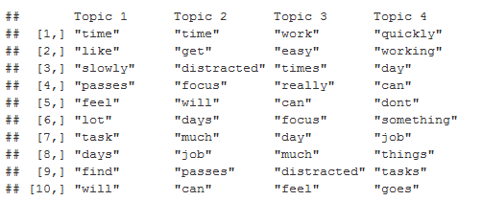
Code Example: Unsupervised (Topic Modeling)

Slide 72
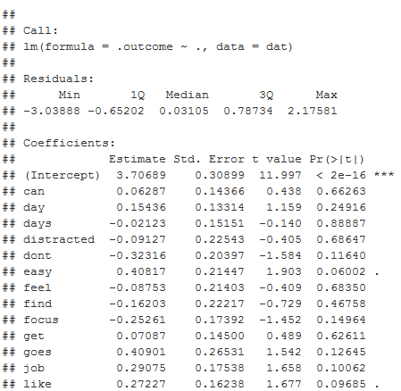
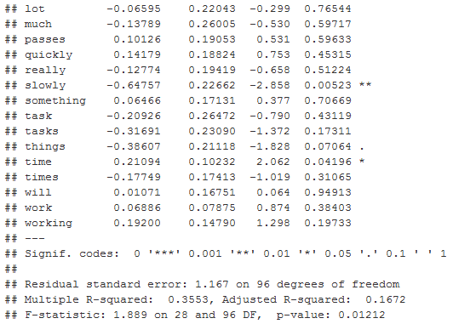
Code Example: Supervised Learning (Linear Regression)

Slide 73
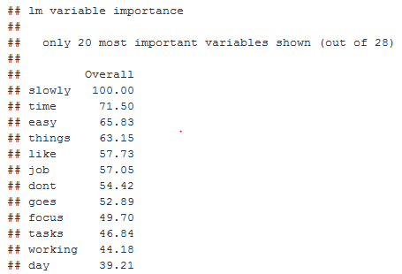
Code Example: Supervised Learning (Linear Regression)

Slide 74
Neighbor Discussion
Which approaches do you see as potentially relevant to your research interests?

Slide 75
Postprocessing
Step 6. Interpretation & Validation

Slide 76
Interpretation & Validation
The purpose of this step is to establish the validity of the results.
Domain experts will be required to assist in the interpretation of the study results, and to identify if, and how, the models can be used to satisfy the original need or opportunity.
As with traditional research methods in I/O psychology, this involves establishing that the text-based measures or models have adequate reliability and validity (i.e., content, criterion, and/or construct).

Slide 77
Reliability
Because word usage is rarely normally distributed, and tends to have very low base rates, typical measures of reliability are not always appropriate (Tausczik & Pennebaker, 2010).
However, there are some traditional reliability analyses that can be used in certain situations. The general advice here is to apply good judgment in their interpretation, and not rely on the numerical value alone.

Slide 78
Two Methods for Calculating Reliability of Text Measures
Test-retest reliability. An assessment of transient error, which can influence the word choice from one time of writing to another. Examples of factors that cause transient error are the emotional state of the author and their working environment at the time of writing. To assess transient error, gather text data from two points in time, and calculate test-retest reliability.
Inter-rater reliability:
Parallel forms reliability. An assessment of specific factor error, or the impact of individual analysts on the results of the model (for example, deciding which words to include in a dictionary). To assess specific factor error when using dictionary-based modeling, manually code at least 10% of the texts being analyzed, and then calculate a parallel forms reliability estimate.
Krippendorff’s alpha. An assessment of “algorithm error” when using dictionaries. To assess algorithm error, calculate Krippendorff’s alpha coefficient by analyzing the same texts with two dictionaries.

Slide 79
Validity
Traditional validation techniques are more easily applied to text-based measures and models (McKenny, et al., 2013), compared to reliability analyses.
Content validation.
SMEs evaluate the output of a text analysis model. Do the results from a topic model adequately cover the construct of interest?
Criterion validation
Correlate scores on a text-based measure of work engagement with employee performance ratings.
Construct validation
Convergent and discriminant validity. Scores on a text-based measure of work engagement can be correlated with a previously validated measure of work engagement to demonstrate convergent validity.
SME input is critical in establishing the validity of text-based measures

Slide 80
Bias & Adverse Impact
In addition to reliability and validity, any text-based models that are used to make employment decisions (e.g., selection, promotion) must also be assessed for potential bias.
The “four-fifths rule” used in selection can also be applied here.
If adverse impact is found, a look at the descriptive statistics of each variable in the model, by various sub-groups, may reveal that some variables are more common in the writing of some groups than others. These variables may need to be removed from the model, or their weights may need to be reduced.
Another consideration is to build a “bias-aware” model. These models avoid adverse impact by taking into account the bias in the model and then adjusting the prediction accordingly.
Notes:
See Sajin (2008) and Bolukbasi et al., (2016) for more information.

Slide 81
Key Considerations (Interpretation & Validation)
1. How will reliability be assessed?
We did not investigate reliability. Test-retest reliability of the topic models and BOW prediction model can be conducted (transient error).
2. How will validity be assessed?
Content. SMEs rate degree to which the absorption topics cover the absorption construct.
Criterion. BOW model on absorption text is correlated with intent to stay scores (concurrent).
Construct. BOW model correlated with quantitative absorption scores (convergent).
3. How will you test for bias?
We did not investigate bias. Investigations into whether the BOW model is equally predictive across different groups can be conducted.
Notes:
If you were using/building a dictionary, could calculate Krippendorff’s alpha from scores produced from two different dictionaries
Could also look at correlation between manually coded and software/dictionary coded text (specific factor/parallel forms)
2. Construct: could be correlated with gma to show discriminant validity
3. 4/5ths rule, correlations with various groups

Slide 82
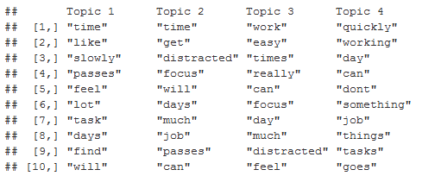
Content Validity
“Absorption refers to being fully concentrated and happily engrossed in one’s work, whereby time passes quickly and one has difficulties with detaching oneself from work” (Schaufeli, 2013)
Evidence of construct deficiency
Open response prompt: “When you are working, do you experience time passing quickly or slowly? Is it easy to focus on your work, or do you get distracted? Please give an example.”
Topic model terms – absorption text
Notes:
Know absorption is a unidimensional construct, but just for the sake of explanation here. As an example …
Cognitive and affective
Absorption, as a sub component of work engagement, is thought of as a unidimensional construct. But, notice in this definition, that there seem to be two aspects, which are likely related, but unique. For example, you could be fully concentrated, but bc you are facing a tight deadline, and you are not happy with the work you need to get done by the end of the day.
RQ 1 – identify drivers from open text prompt (what enjoy about your job)
Topics aren’t clean, maybe because 4 job families?
Also, the info here is job specific, so less about the organization – and the drivers of interest are often things that are at the organizational level (e.g., communication from senior leadership, benefits, having the right technology …)
Identify a couple of areas that might want to investigate: learning something new, flexible hours; helping people/customers
RQ 2 – develop text measure of absorption
Evidence of content deficiency

Slide 83
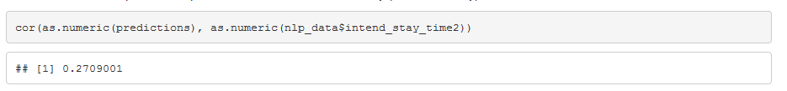
Criterion Validity
Scores from the text-based absorption measure correlated with intent to stay
Evidence of criterion related validity
Notes:
Compare with absorption scale.
Mention BOW score distribution issues, not close to normal, can effect observed correlation
Sig related to IS, conclude CRV
Quant absorption and quant intent to stay = .50
Stat sig?

Slide 84
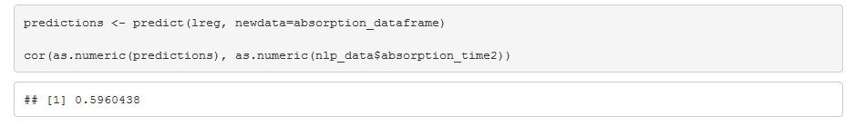
Construct Validity
Scores from the text-based absorption measure correlated with scores from previously validated absorption scale (convergent validity)
Evidence of construct validity
Notes:
Built on this scale, so bit of an unfair analysis.
Ideally, we would use a separate scale of absorption. Or, cross-validate in a hold out sample. However, we did use k-fold cv to build this model.
Could also look at relationship with gma for discriminant validity.
Convergent validity may exist when two measures of the same variable are more highly correlated with each other than with measures of other variables. Convergent validity is determined by viewing the validity correlation coefficients, which were marked by the superscript a in Table 4. These three coefficients should be significant (which they are) and should be higher than other coefficients in their respective column or row.
Large effect size, Bosca & Aguinis (2015) JAP

Slide 85
Agenda
What is NLP?
Highlights from the literature
NLP process, considerations, and walkthrough
Applied NLP in HR

Slide 86
Applied NLP in HR

Slide 87
Examples of NLP in HR
Sources of text which are fueling NLP-driven advancements in HR:
Job description
Job applications
Candidate assessment
Employee surveys
Performance appraisals

Slide 88
Job Description Text
Recent research (e.g., Gaucher, Friesen, & Kay, 2011) shows that both what is written in a job description, as well as how it is worded, has an effect on the application rates from various groups.
Develop a diverse applicant pool by identifying relationships between specific words used to describe the job.
For example, women are less likely to apply for a job that is described as “managing” versus “developing” a team.
Large amounts of data and computational advancements have enabled a form of targeted advertising (e.g., LinkedIn).
Applying this technique to job postings, organizations can identify and directly reach out to individuals who have a higher likelihood of being interested in a particular role.
For example, an organization that has historically recruited from a certain university for entry-level roles, may find that there is a much wider, and more diverse, pool of qualified applicants that can be reached with targeted advertising.

Slide 89
Application Text
Advancements in computational power and predictive modeling now enable more efficient use of “unstructured” data (e.g., text).
Currently, Applicant Tracking Systems (ATS) provide basic keyword screening of candidate applications. However, applying NLP can transform this process into a validated selection tool. Specific words and phrases which predict performance and turnover are being used to build predictive models.
Behavioral questions are sent to a candidate’s references. Predictive models are built on the words used to describe the candidate.

Slide 90
Assessment Text
NLP has been applied to text captured during the assessment process and used to measure psychological constructs
Assessing text captured from video interviews to identify the candidate’s choice of words (e.g., active verbs versus negative verbs)
Text-based responses in an online job simulation have been used to create psychological profiles which predict fit with company culture
At the manifest level, NLP has been applied to transcribed interview responses to help recruiters identify candidates who mention key words that are associated with the job.

Slide 91
Survey Text
NLP has been used to identify topics from employee survey comments.
Relationships among topics.
Topics spoken about by engaged versus disengaged employees.
As well as identifying sentiment
A combination of topics (what is talked about) and sentiment (how it is talked about) allows for a richer understanding of the employee experience.

Slide 92
Performance Text
The quality of employee performance and development goals is being analyzed, and automated suggestions are provided to help make them SMARTer.
NLP models suggest mini-goals and scheduled check-in points, provide manager scripts for check-ins.
Provide feedback to call center agents on their responses to customers.
Improve a manager’s communication skills by analyzing their speaking style.
How much they talk within a conversation, number of times they use “I” instead of “we”.

Slide 93
Summary

Slide 94
There is a Growing Interest in NLP in I/O Psychology…
In research
Increasing number of articles using text analysis and NLP (e.g., Campion et al., 2016; Kobayashi et al., 2017; Speer, 2018)
In practice
Sophisticated use of NLP across HR (e.g., selection, surveys, performance)
The tools (e.g., R, Python) and necessary information to conduct NLP are readily available
Expect to see a large amount of NLP-driven innovation across HR in the coming years
Notes:
Necessary info: literature examples, package documentation, forums to help troubleshoot your analysis/cleaning etc.

Slide 95
Recommended Resources
Available software (some open-source, some not)
R (tm, topicmodels, caret, openNLP)
Python (spaCy, nltk, genism, scikit-learn)
RapidMiner
QDAMiner
SPSS Premium Modeler package
Wordstat
Data and code from this session
https://github.com/coryamanda/SIOP2019_NLP_Organization_Research

Slide 96
The Last Slide!
What do I do now?
Review the remaining considerations
Conduct a text analysis study
Recommended reading
Kobayashi, Mol, Berkers, Kismihok, & Hartog, 2017
Banks, Woznyj, Wesslen, & Ross, 2018
McKenny, Aguinis, Short, & Anglin, 2018
Short, Broberg, Cogliser, & Brigham, 2009
Speer, 2018
Pandey & Pandey, 2017
Campion, Campion, Campion, & Reider, 2016
Manning, Prabhakar, & Hinrich, 2008

Slide 97
James Meaden Cory Kind
Research Scientist, SHL Research Scientist, SHL
571-458-2186 571-458-3458
james.meaden@shl.com cory.kind@shl.com

Slide 98
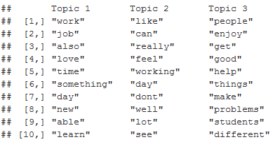
Content Validity
Topic model terms – absorption text
Topic model terms – enjoyment text
“Absorption refers to being fully concentrated and happily engrossed in one’s work, whereby time passes quickly and one has difficulties with detaching oneself from work” (Schaufeli, 2013)
Evidence of construct deficiency.
Open response prompt: “When you are working, do you experience time passing quickly or slowly? Is it easy to focus on your work, or do you get distracted? Please give an example.”
Topic 1: able, learn, new, everyday; flexible, hours
Topic 2: ?
Topic 3: helping, people, customers
Evidence of drivers of job satisfaction: learning, flexible hours; helping people/customers
Open response prompt: “What do you like most about your job?”
Notes:
Absorption, as a sub component of work engagement, is thought of as a unidimensional construct. But, notice in this definition, that there seem to be two aspects, which are likely related, but unique. For example, you could be fully concentrated, but bc you are facing a tight deadline, and you are not happy with the work you need to get done by the end of the day.
RQ 1 – identify drivers from open text prompt (what enjoy about your job)
Topics aren’t clean, maybe because 4 job families?
Also, the info here is job specific, so less about the organization – and the drivers of interest are often things that are at the organizational level (e.g., communication from senior leadership, benefits, having the right technology …)
Identify a couple of areas that might want to investigate: learning something new, flexible hours; helping people/customers
RQ 2 – develop text measure of absorption
Evidence of content deficiency

Slide 99
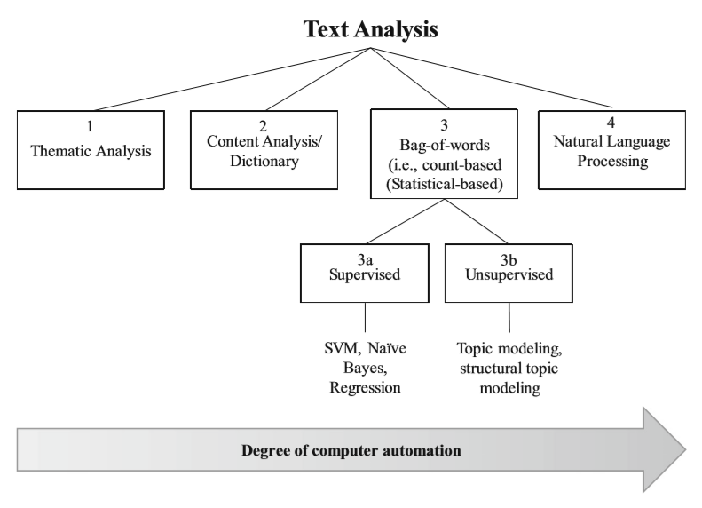
Categorization of Common Text Analysis Techniques
From Banks, Woznyj, Wesslen, & Ross (2018)
Notes:
NLP here = word order matters

